Slide 1
CHAPTER 2:
Visual Description of Data
to accompany
Introduction to Business Statistics
seventh edition, by Ronald M. Weiers
Presentation by Priscilla Chaffe-Stengel
Donald N. Stengel
© 2011 Cengage Learning.
All Rights Reserved. May not be scanned, copied, or duplicated, or posted to a publicly accessible website, in part or in whole.

Slide 2
Chapter 2 - Learning Objectives
Convert raw data into a data array.
Construct:
  a frequency distribution and a histogram.
  a relative and a cumulative frequency distribution.
  a stem-and-leaf diagram.
Visually represent data by using graphs and charts.
Construct a dot plot and a scatter diagram.
Construct contingency tables.
© 2011 Cengage Learning.
All Rights Reserved. May not be scanned, copied, or duplicated, or posted to a publicly accessible website, in whole or in part.

Slide 3
Chapter 2 - Key Terms
Data array
  An orderly presentation of data in either ascending or descending numerical order.
Frequency Distribution
  A table that represents the data in classes and that shows the number of observations in each class.
© 2011 Cengage Learning.
All Rights Reserved. May not be scanned, copied, or duplicated, or posted to a publicly accessible website, in whole or in part.

Slide 4
Chapter 2 - Key Terms
Frequency Distribution
  Class - The category
  Frequency - Number in each class
  Class limits - Boundaries for each class
  Class interval - Width of each class
  Class mark - Midpoint of each class
© 2011 Cengage Learning.
All Rights Reserved. May not be scanned, copied, or duplicated, or posted to a publicly accessible website, in whole or in part.

Slide 5
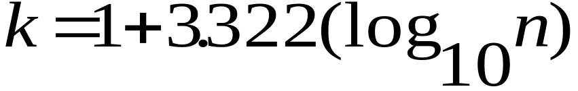
Sturges’ rule
How to set the approximate number of classes to begin constructing a frequency distribution.
  where k = approximate number of classes to use and
  n = the number of observations in the data set .
© 2011 Cengage Learning.
All Rights Reserved. May not be scanned, copied, or duplicated, or posted to a publicly accessible website, in whole or in part.

Slide 6
How to Construct a
Frequency Distribution
1. Number of classes
Choose an approximate number of classes for your data. Sturges’ rule can help.
2. Estimate the class interval
Divide the approximate number of classes (from Step 1) into the range of your data to find the approximate class interval, where the range is defined as the largest data value minus the smallest data value.
3. Determine the class interval
Round the estimate (from Step 2) to a convenient value.
© 2011 Cengage Learning.
All Rights Reserved. May not be scanned, copied, or duplicated, or posted to a publicly accessibl website, in whole or in part.

Slide 7
How to Construct a
Frequency Distribution, cont.
4. Lower Class Limit
Determine the lower class limit for the first class by selecting a convenient number that is smaller than the lowest data value.
5. Class Limits
Determine the other class limits by repeatedly adding the class width (from Step 2) to the prior class limit, starting with the lower class limit (from Step 3).
6. Define the classes
Use the sequence of class limits to define the classes.
© 2011 Cengage Learning.
All Rights Reserved. May not be scanned, copied, or duplicated, or posted to a publicly accessible website, in whole or in part.

Slide 8
Converting to a Relative Frequency Distribution
1. Retain the same classes defined in the frequency distribution.
2. Sum the total number of observations across all classes of the frequency distribution.
3. Divide the frequency for each class by the total number of observations, forming the percentage of data values in each class.
© 2011 Cengage Learning.
All Rights Reserved. May not be scanned, copied, or duplicated, or posted to a publicly accessible website, in whole or in part.

Slide 9
Forming a Cumulative Relative Frequency Distribution
1. List the number of observations in the lowest class.
2. Add the frequency of the lowest class to the frequency of the second class. Record that cumulative sum for the second class.
3. Continue to add the prior cumulative sum to the frequency for that class, so that the cumulative sum for the final class is the total number of observations in the data set.
© 2011 Cengage Learning.
All Rights Reserved. May not be scanned, copied, or duplicated, or posted to a publicly accessible website, in whole or in part.

Slide 10
Forming a Cumulative Relative Frequency Distribution, cont.
4. Divide the accumulated frequencies for each class by the total number of observations -- giving you the percent of all observations that occurred up to an including that class.
An Alternative: Accrue the relative frequencies for each class instead of the raw frequencies. Then you don’t have to divide by the total to get percentages.
© 2011 Cengage Learning.
All Rights Reserved. May not be scanned, copied, or duplicated, or posted to a publicly accessible website, in whole or in part.

Slide 11
Example: Problem 2.57
The average daily cost to community hospitals for patient stays during 2006 for each of the 50 U.S. states was given in the next table.
  a) Construct a stem-and-leaf display.
  *) Approximately how many classes would be appropriate for these data? [*not in textbook]
  b & c) Construct a frequency distribution. State interval width and class mark.
  d) Construct a histogram and a relative frequency polygon.
© 2011 Cengage Learning.
All Rights Reserved. May not be scanned, copied, or duplicated, or posted to a publicly accessible website, in whole or in part.

Slide 12
Problem 2.57 - The Data
AL $1274 HI 1383 MA 1895 NM 1738 SD 774
AK 2455 ID 1511 MI 1608 NY 1602 TN 1349
AZ 1930 IL 1676 MN 1379 NC 1362 TX 1752
AR 1304 IN 1699 MS 1100 ND 966 UT 1914
CA 2056 IA 1093 MO 1687 OH 1773 VT 1355
CO 1864 KS 1155 MT 924 OK 1379 VA 1491
CT 1839 KY 1318 NE 1180 OR 2202 WA 2298
DE 1634 LA 1288 NV 1544 PA 1601 WV 1152
FL 1595 ME 1627 NH 1714 RI 1824 WI 1566
GA 1243 MD 2009 NJ 1910 SC 1487 WY 906
© 2011 Cengage Learning.
All Rights Reserved. May not be scanned, copied, or duplicated, or posted to a publicly accessible website, in whole or in part.

Slide 13
Problem 2.57 a.
The Stem-and-Leaf Display
Stem-and-Leaf Display, N = 50, Leaf Unit: 100
1 7 7
0 8
3 9 026
1 10 9
4 11 0558
3 12 478
8 13 01456778
2 14 89
4 15 1469
8 16 00023789
4 17 1369
4 18 2369
3 19 113
2 20 05
0 21
2 22 09
0 23
1 24 5
© 2011 Cengage Learning.
All Rights Reserved. May not be scanned, copied, or duplicated, or posted to a publicly accessible website, in whole or in part.

Slide 14
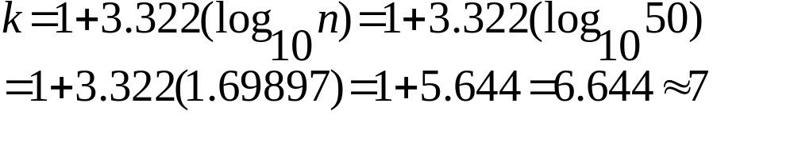
Problem 2.57 - Continued
To approximate the number of classes we should use in creating the frequency distribution, use Sturges’ Rule, n = 50:
Sturges’ rule suggests we use approximately 7 classes.
© 2011 Cengage Learning.
All Rights Reserved. May not be scanned, copied, or duplicated, or posted to a publicly accessible website, in whole or in part.

Slide 15
Constructing the Frequency Distribution
Step 1. Number of classes
  Sturges’ Rule: approximately 7 classes.
The range is: $2455 - $774 = $1681
$1681 ÷ 7 ≈ $240
Steps 2 & 3. The Class Interval
  So, if we use 7 classes, we can make each class $250 wide.
© 2011 Cengage Learning.
All Rights Reserved. May not be scanned, copied, or duplicated, or posted to a publicly accessible website, in whole or in part.

Slide 16
Constructing the Frequency Distribution
Step 4. The Lower Class Limit
  If we start at $750, we can cover the range in 7 classes, each class $250 in width.
  The first class : $750 up to $1000
Steps 5 & 6. Setting Class Limits
  $750 up to $1000 $1750 up to $2000
  $1000 up to $1250 $2000 up to $2250
  $1250 up to $1500 $2250 up to $2500
  $1500 up to $1750
© 2011 Cengage Learning.
All Rights Reserved. May not be scanned, copied, or duplicated, or posted to a publicly accessible website, in whole or in part.

Slide 17
Problem 2.57 c. & d.
Average daily cost Number Mark
$750 – under $1000 4 $875
$1000 – under $1250 6 $1125
$1250 – under $1500 12 $1375
$1500 – under $1750 14 $1625
$1750 – under $2000 9 $1875
$2000 – under $2250 3 $2125
$2250 – under $2500 2 $2375
Interval width: $250
© 2011 Cengage Learning.
All Rights Reserved. May not be scanned, copied, or duplicated, or posted to a publicly accessible website, in whole or in part.

Slide 18
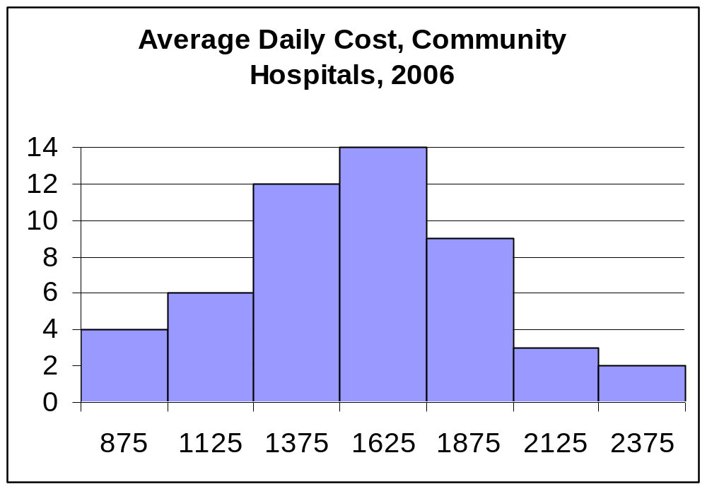
Problem 2.57 d. The Histogram
© 2011 Cengage Learning.
All Rights Reserved. May not be scanned, copied, or duplicated, or posted to a publicly accessible website, in whole or in part.

Slide 19
Problem 2.57 - The Relative Frequency Distribution
Average daily cost Number Rel. Freq.
$750 – under $1000 4 4/50 = .08
$1000 – under $1250 6 6/50 = .12
$1250 – under $1500 12 12/50 = .24
$1500 – under $1750 14 14/50 = .28
$1750 – under $2000 9 9/50 = .18
$2000 – under $2250 3 3/50 = .06
$2250 – under $2500 2 2/50 = .04
© 2011 Cengage Learning.
All Rights Reserved. May not be scanned, copied, or duplicated, or posted to a publicly accessible website, in whole or in part.

Slide 20
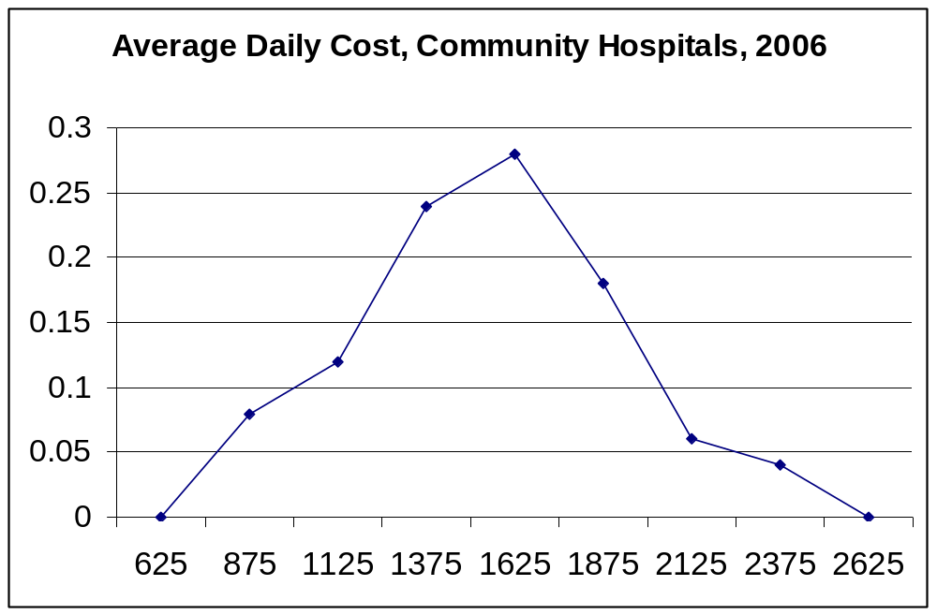
Problem 2.57 d. The Percentage Polygon
© 2011 Cengage Learning.
All Rights Reserved. May not be scanned, copied, or duplicated, or posted to a publicly accessible website, in whole or in part.

Slide 21
Problem 2.57 - The Cumulative Frequency Distribution
Average daily cost Number Cum. Freq.
$750 – under $1000 4 4
$1000 – under $1250 6 10
$1250 – under $1500 12 22
$1500 – under $1750 14 36
$1750 – under $2000 9 45
$2000 – under $2250 3 48
$2250 – under $2500 2 50
© 2011 Cengage Learning.
All Rights Reserved. May not be scanned, copied, or duplicated, or posted to a publicly accessible website, in whole or in part.

Slide 22
Problem 2.57 - The Cumulative Relative Frequency Distribution
Average daily cost Cum. Freq. Cum. Rel. Freq.
$750 – under $1000 4 4/50 = .08
$1000 – under $1250 10 10/50 = .20
$1250 – under $1500 22 22/50 = .44
$1500 – under $1750 36 36/50 = .72
$1750 – under $2000 45 45/50 = .90
$2000 – under $2250 48 48/50 = .96
$2250 – under $2500 50 50/50 = 1.00
© 2011 Cengage Learning.
All Rights Reserved. May not be scanned, copied, or duplicated, or posted to a publicly accessible website, in whole or in part.

Slide 23
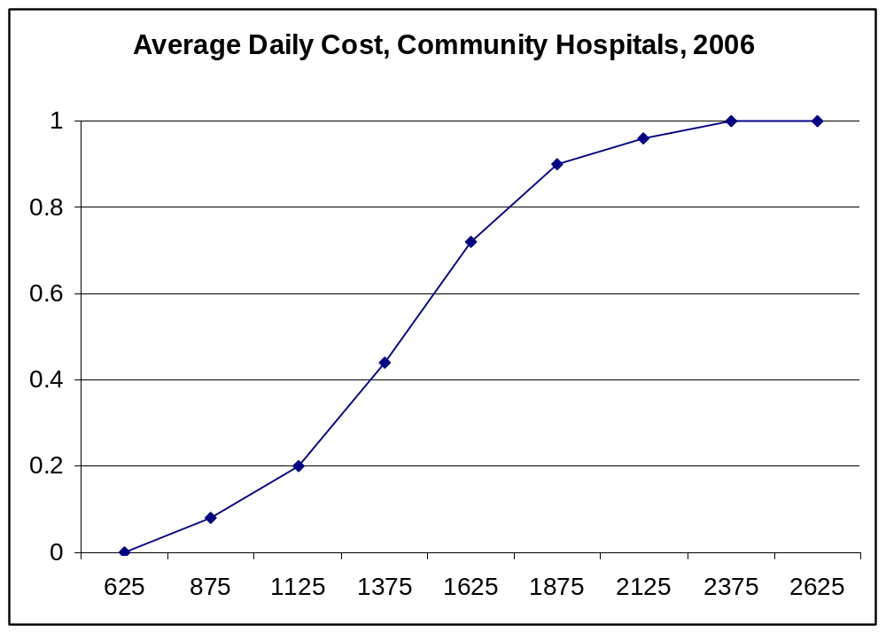
Problem 2.57 - The Percentage
Ogive (Less Than)
© 2011 Cengage Learning.
All Rights Reserved. May not be scanned, copied, or duplicated, or posted to a publicly accessible website, in whole or in part.

Slide 24
The Scatter Diagram
A scatter diagram is a two-dimensional plot of data representing values of two quantitative variables.
  x, the independent variable, on the horizontal axis
  y, the dependent variable, on the vertical axis
Four ways in which two variables can be related:
1. Direct 2. Inverse 3. Curvilinear
4. No relationship
© 2011 Cengage Learning.
All Rights Reserved. May not be scanned, copied, or duplicated, or posted to a publicly accessible website, in whole or in part.

Slide 25
An Example: Problem 2.42
For 6 local offices of a large tax preparation firm, the following data describe x = service revenues and y = expenses for supplies, freight, postage, etc.
  Draw a scatter diagram representing the data. Does there appear to be any relationship between the variables? If so, is the relationship direct or inverse?
© 2011 Cengage Learning.
All Rights Reserved. May not be scanned, copied, or duplicated, or posted to a publicly accessible website, in whole or in part.

Slide 26
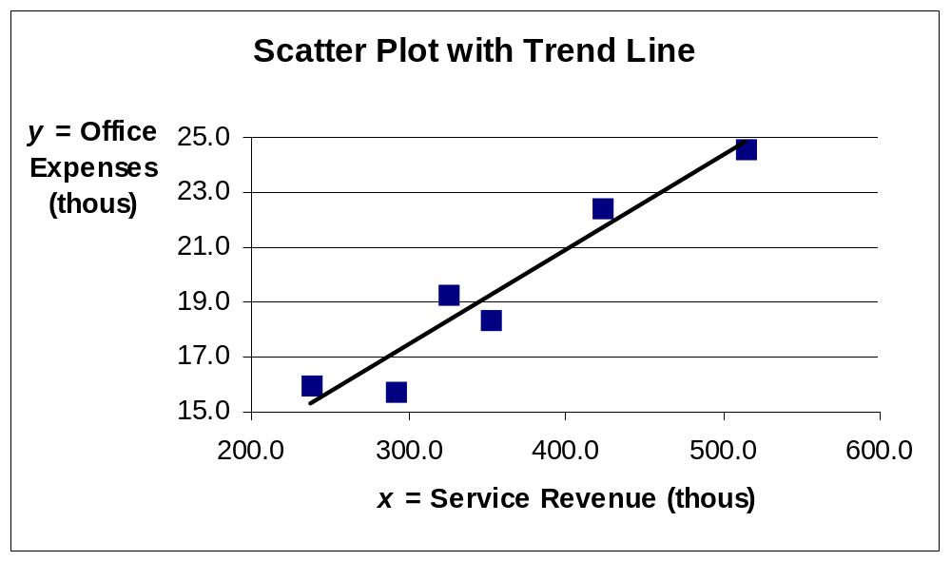
Problem 2.42, continued
There appears to be a direct relationship between
the service revenue and the office expenses incurred.
© 2011 Cengage Learning.
All Rights Reserved. May not be scanned, copied, or duplicated, or posted to a publicly accessible website, in whole or in part.

Slide 27
Problem 2.48
The 30 vehicles operated by a taxi service have been listed according to their engine (1 = diesel, 2 = gasoline), transmission (1 = manual, 2 = automatic), and whether they have air condition (1 = no air conditioning, 2 = air conditioning). These characteristics, along with the miles per gallon (mpg) achieved by each vehicle during the past month are listed on page 47.
© 2011 Cengage Learning.
All Rights Reserved. May not be scanned, copied, or duplicated, or posted to a publicly accessible website, in whole or in part.

Slide 28
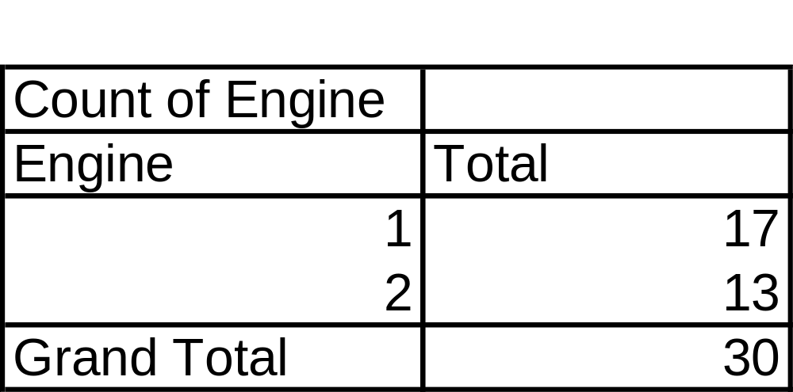
Problem 2.48 – a.
a. Construct a simple tabulation of counts by type of engine.
© 2011 Cengage Learning.
All Rights Reserved. May not be scanned, copied, or duplicated, or posted to a publicly accessible website, in whole or in part.

Slide 29
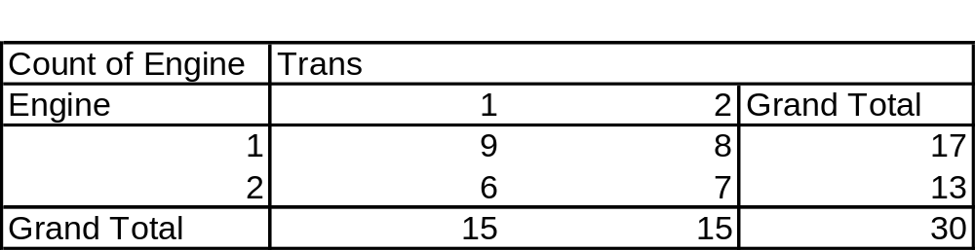
Problem 2.48 – b.
b. Construct a cross-tabulation describing the fleet, using type of engine and type of transmission as the categorization variables.
© 2011 Cengage Learning.
All Rights Reserved. May not be scanned, copied, or duplicated, or posted to a publicly accessible website, in whole or in part.

Slide 30
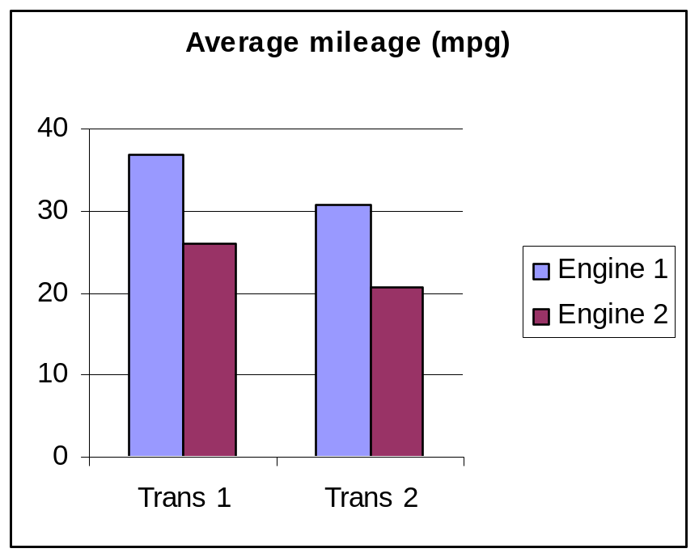
Problem 2.48 – c.
c. Construct a display showing the average mpg according to type of engine and type of transmission.
There is evidence that both type of engine and type of transmission affect mpg achieved by the taxi service.
© 2011 Cengage Learning.
All Rights Reserved. May not be scanned, copied, or duplicated, or posted to a publicly accessible website, in whole or in part.

